Slide 1

Wireshark Day 1
The Handsome Seastars
Notes:
This meme is too dank

Slide 2

The Handsome Seastars

Slide 3
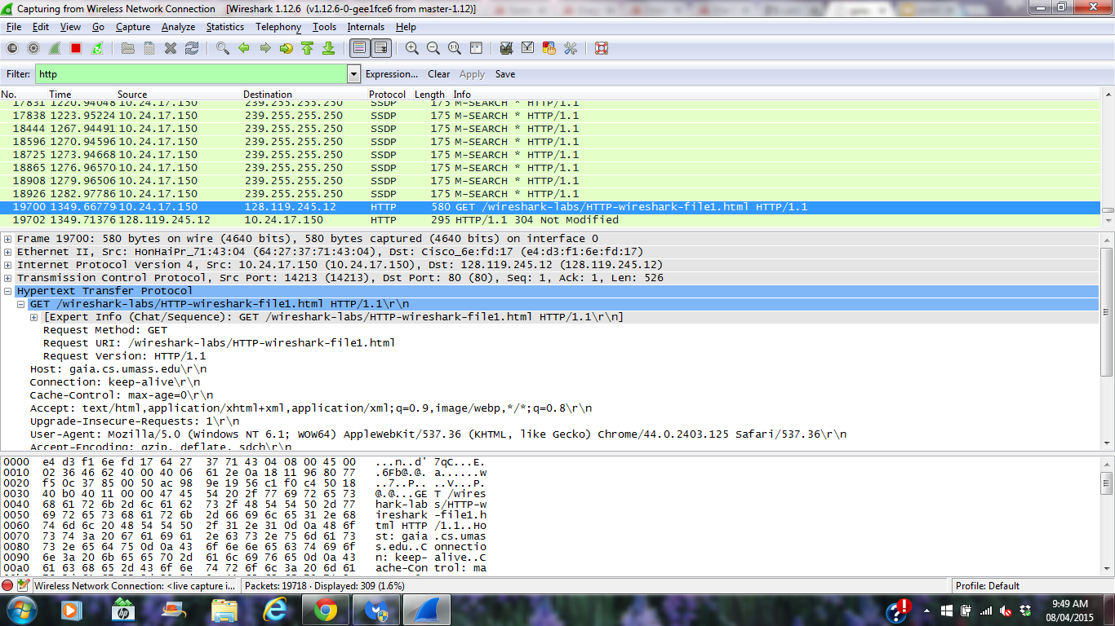
HTTP
Look for the packet with the URL you want

Slide 4
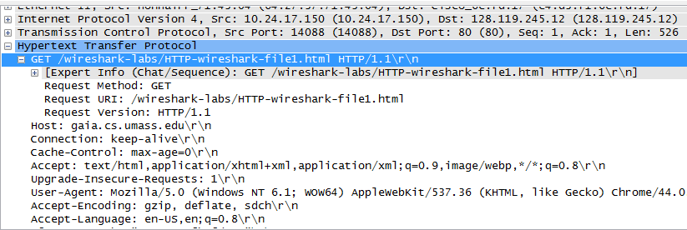
HTTP
We can quickly find the IP addresses, the version number, and the accepted languages here

Slide 5
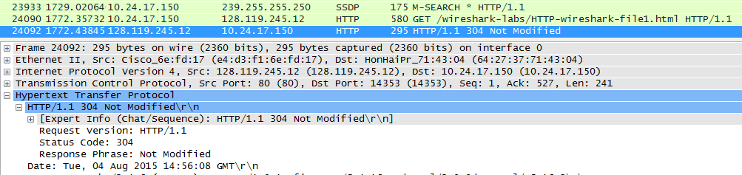
HTTP
Directly below the first packet, we find another with the status code

Slide 6
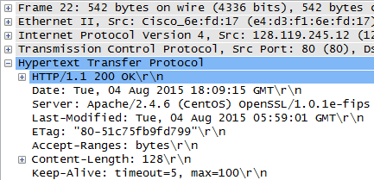
HTTP
The ‘Last-Modified’ line shows when the file was last modified

Slide 7
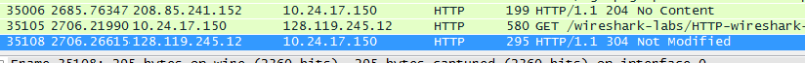
HTTP
Because the first packet is a get request to the server, the second will be the server’s response. By looking at the length, we can see how many bytes we are receiving.

Slide 8
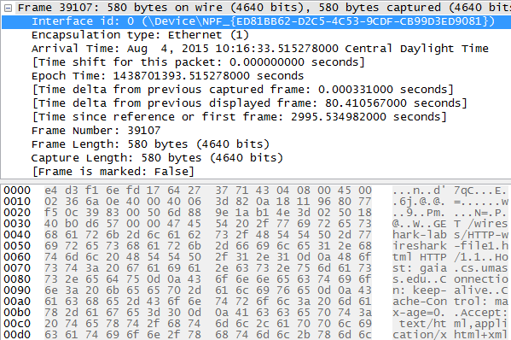
HTTP
Data we found in header, All info within the ‘frame’
not in packet: Stream Index (TCP)
Next sequence number (TCP)
SEQ/ACK analysis
‘Expert Info’ (HTTP)
Full request URI
Packet response in frame #...

Slide 9
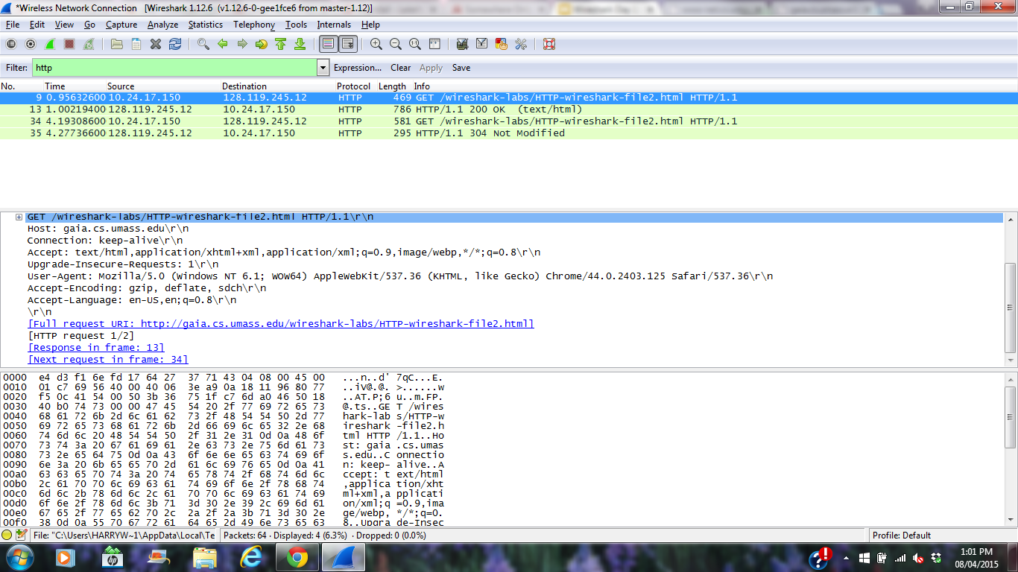
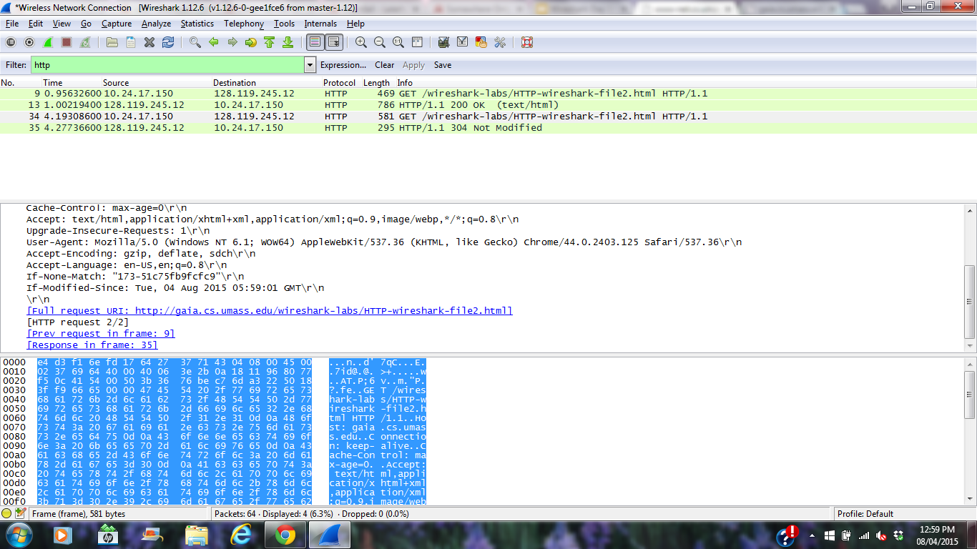
HTTP Extended
As further work, we loaded a web page twice and had to find more data about it. In the first packet, there is no ‘IF-MODIFIED-SINCE’, but it appears in the second packet, with today’s date
1)
2)

Slide 10
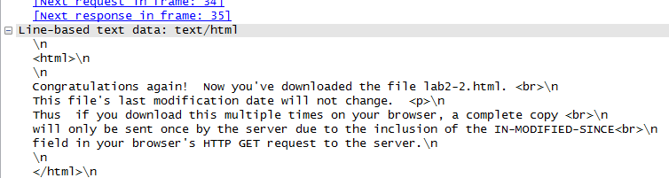
HTTP Extended
In addition, the first server response includes the full contents of the web page, as can be seen below

Slide 11
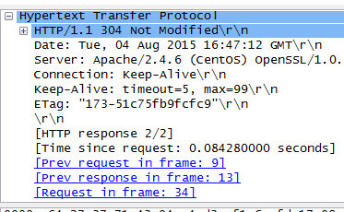
HTTP Extended
However, the second response does not contain the file, and instead returned a service code 304 with the note ‘Not Modified’

Slide 12
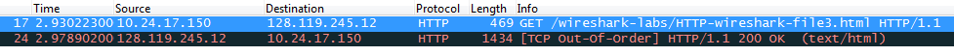
HTTP Extended
For a large page, we can see that my computer still only sends one GET request (packet # 17) and receives the status ‘200 OK’ from the server (packet #24)

Slide 13
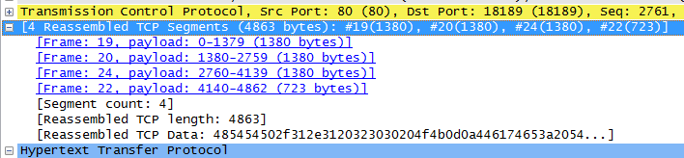
HTTP Extended
But, in order to transfer this web page, the server needed to send four TCP segments

Slide 14
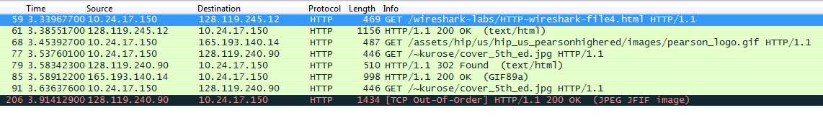
HTTP Extended
The next webpage contained two images. In order to display the page, my computer sent 4 GET requests to 128.119.245.12, 165.193.140.14, and 128.119.240.90. Two were sent to the last one, and investigation revealed that the image had been moved, and the packet redirected the computer to another address

Slide 15
HTTP Extended
It appears that the images were downloaded in parallel, as both the GET requests were sent before any confirmation was received.

Slide 16
TCP
The Handsome Seastars

Slide 17
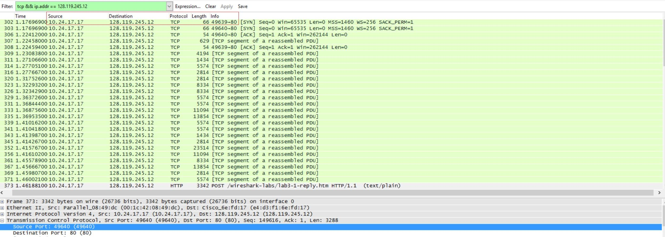
Finding Server & Client IP + Port
Promiscuous mode: OFF

Slide 18
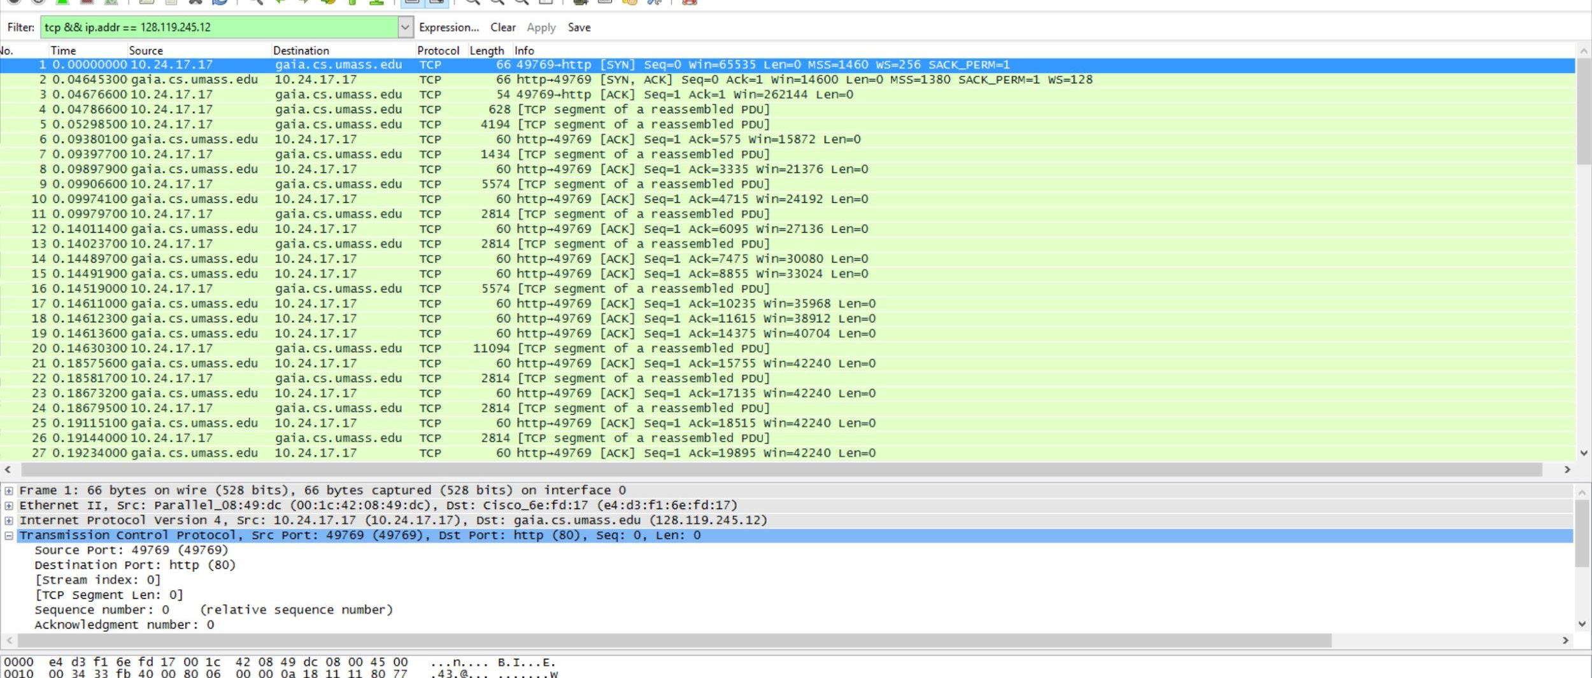
Finding SYN & SYNACK Seq #
0, 0

Slide 19
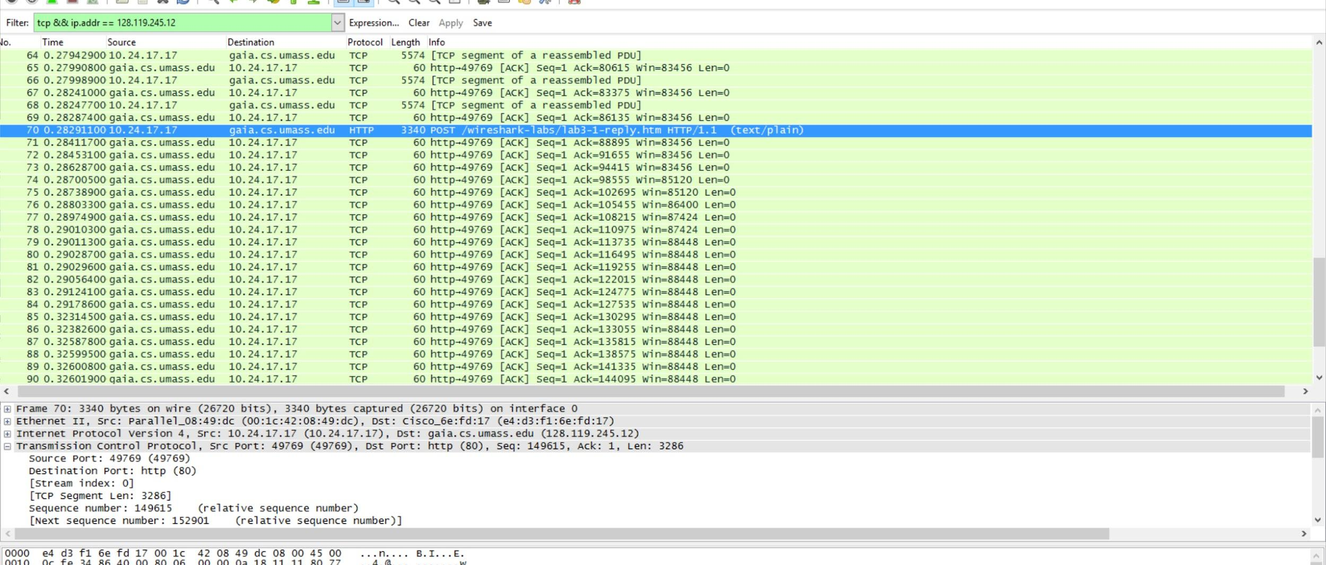
Finding POST Request Seq #
149615

Slide 20
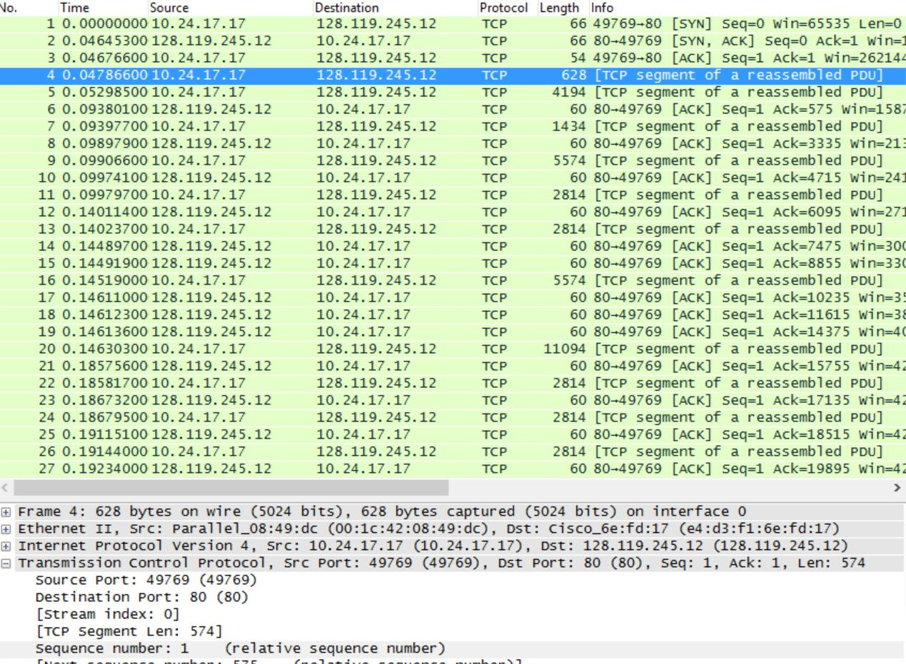
Finding 1st segment info

Slide 21
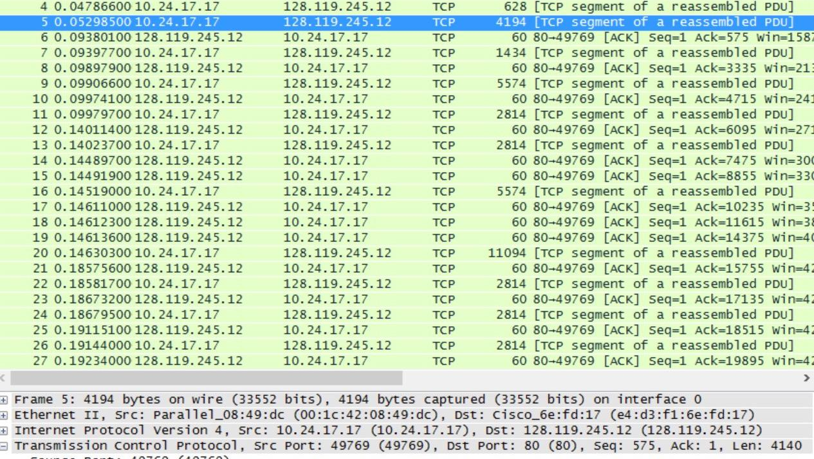
Finding 2nd segment info

Slide 22
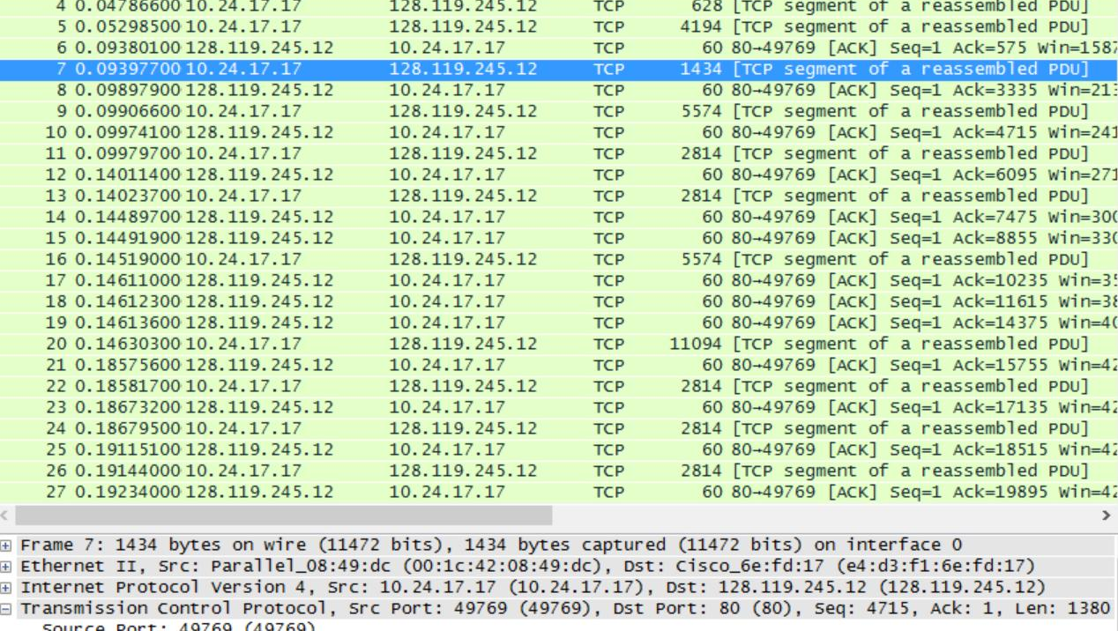
Finding 3rd segment info

Slide 23
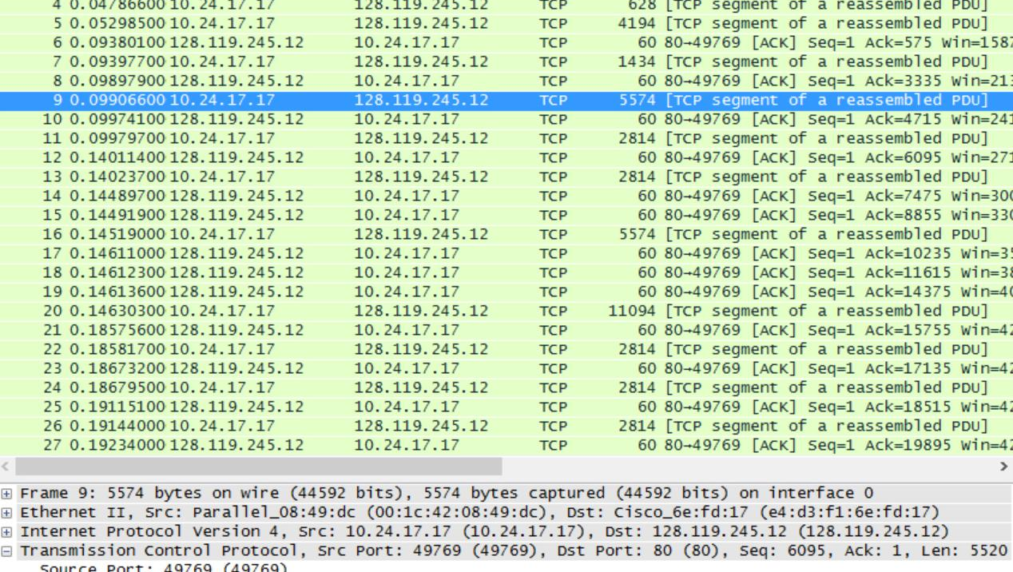
Finding 4th segment info

Slide 24
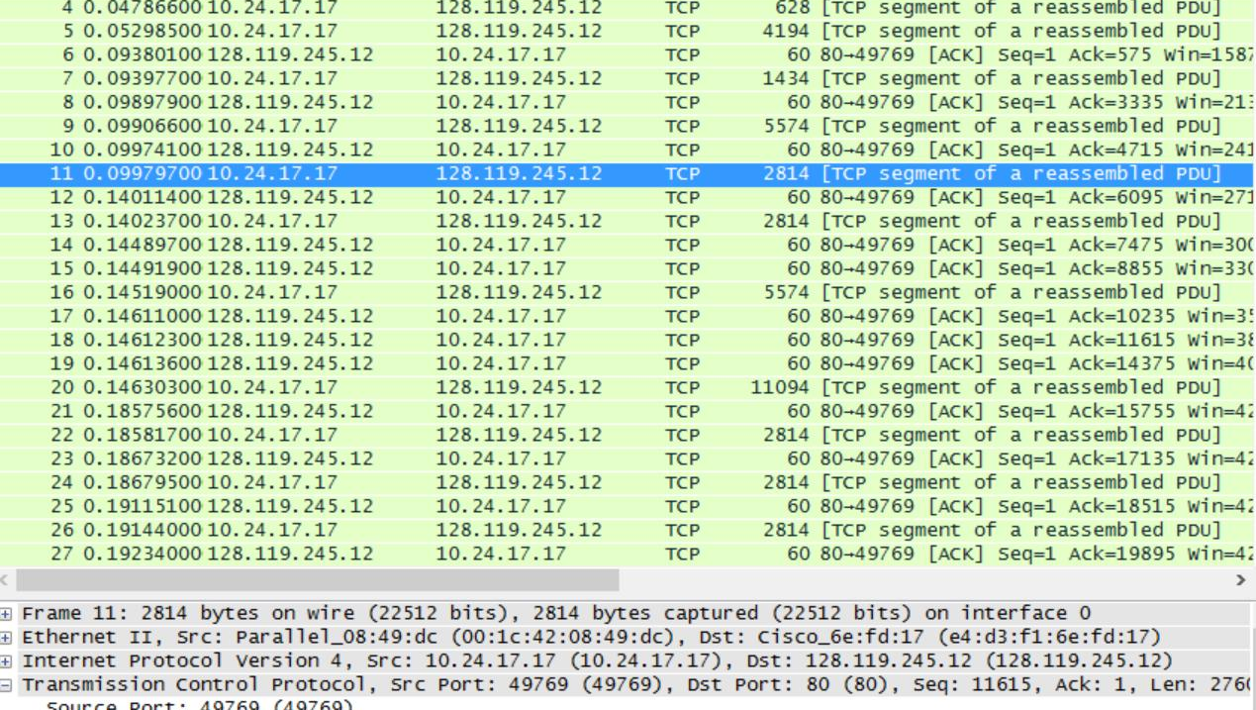
Finding 5th segment info

Slide 25
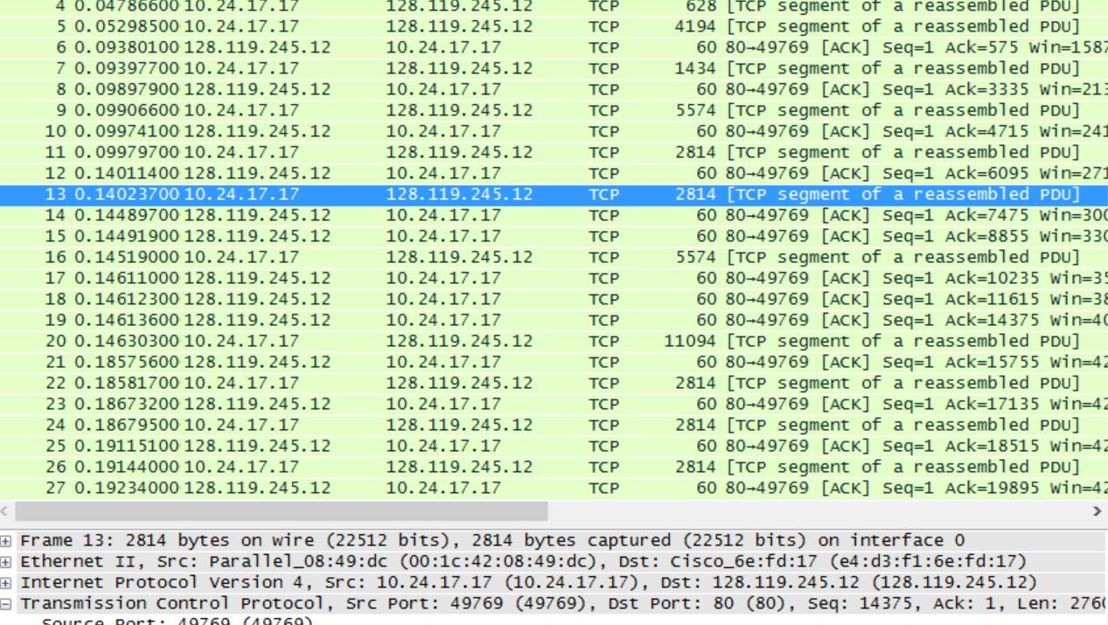
Finding 6th segment info

Slide 26
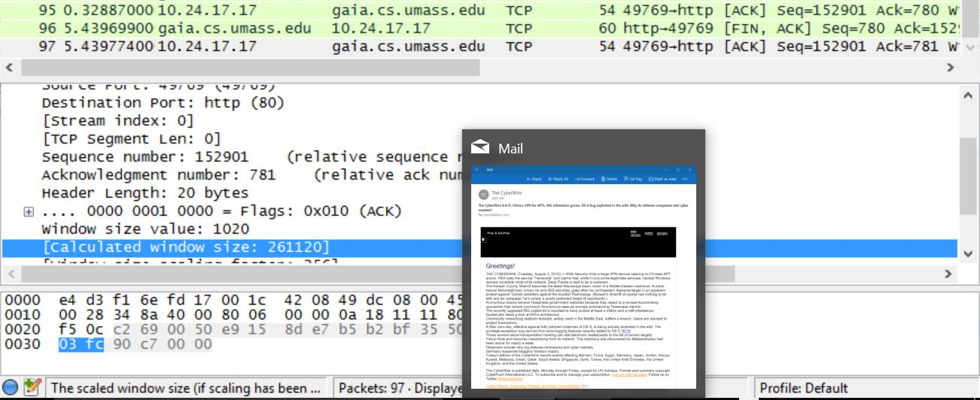
Finding the min. avail. buffersize

Slide 27
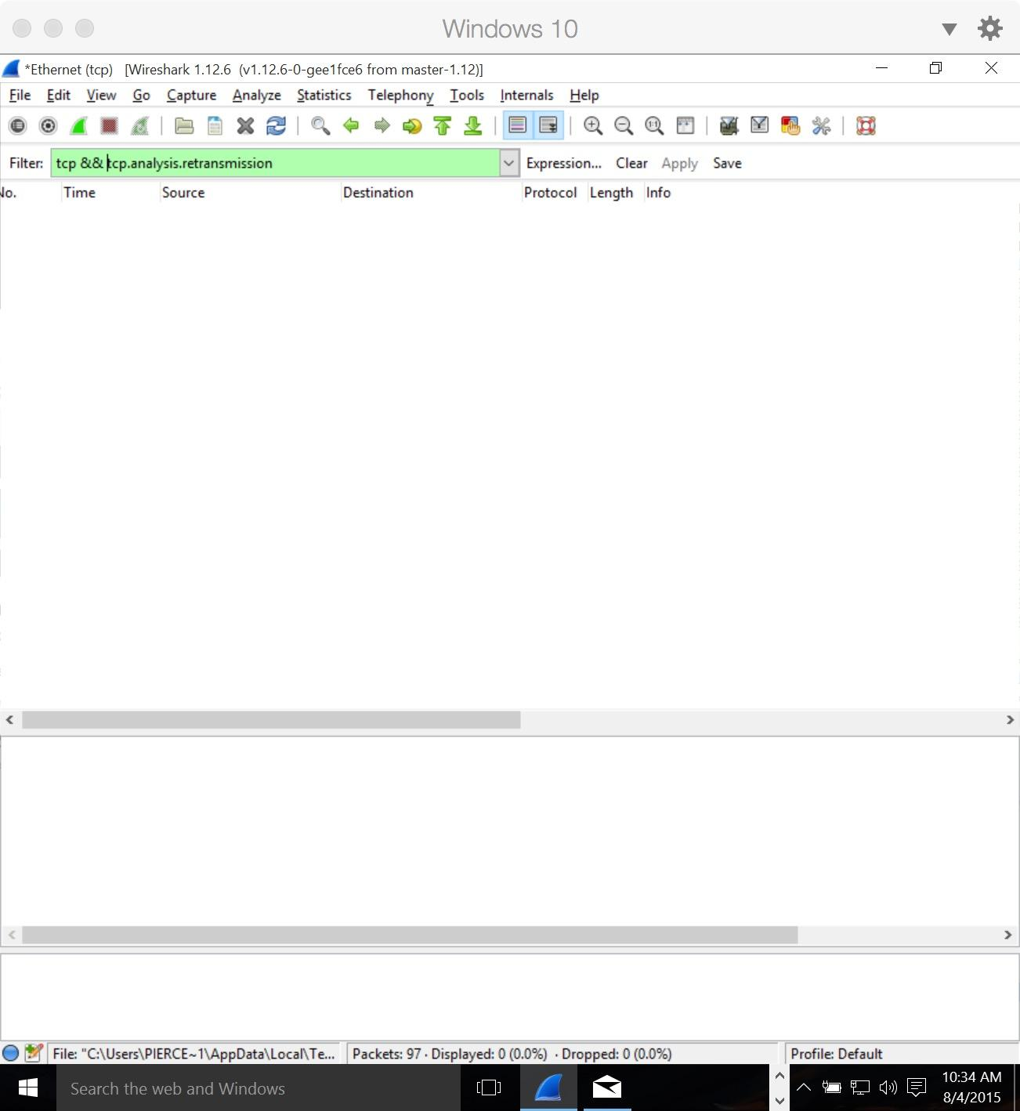
Filtering retransmitted segments

Slide 28
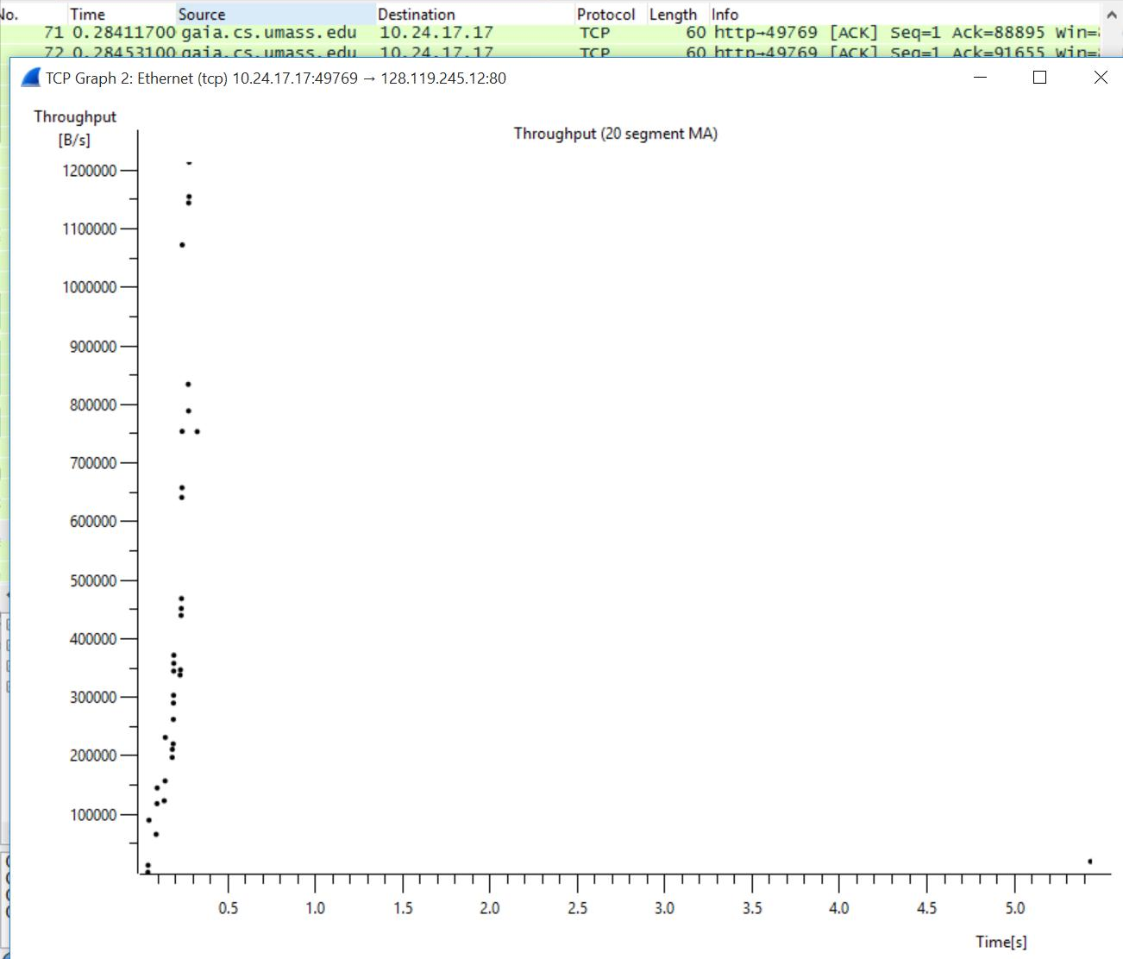
Finding the TCP throughput
Statistics >
TCP StreamGraph >
Throughput Graph

Slide 29
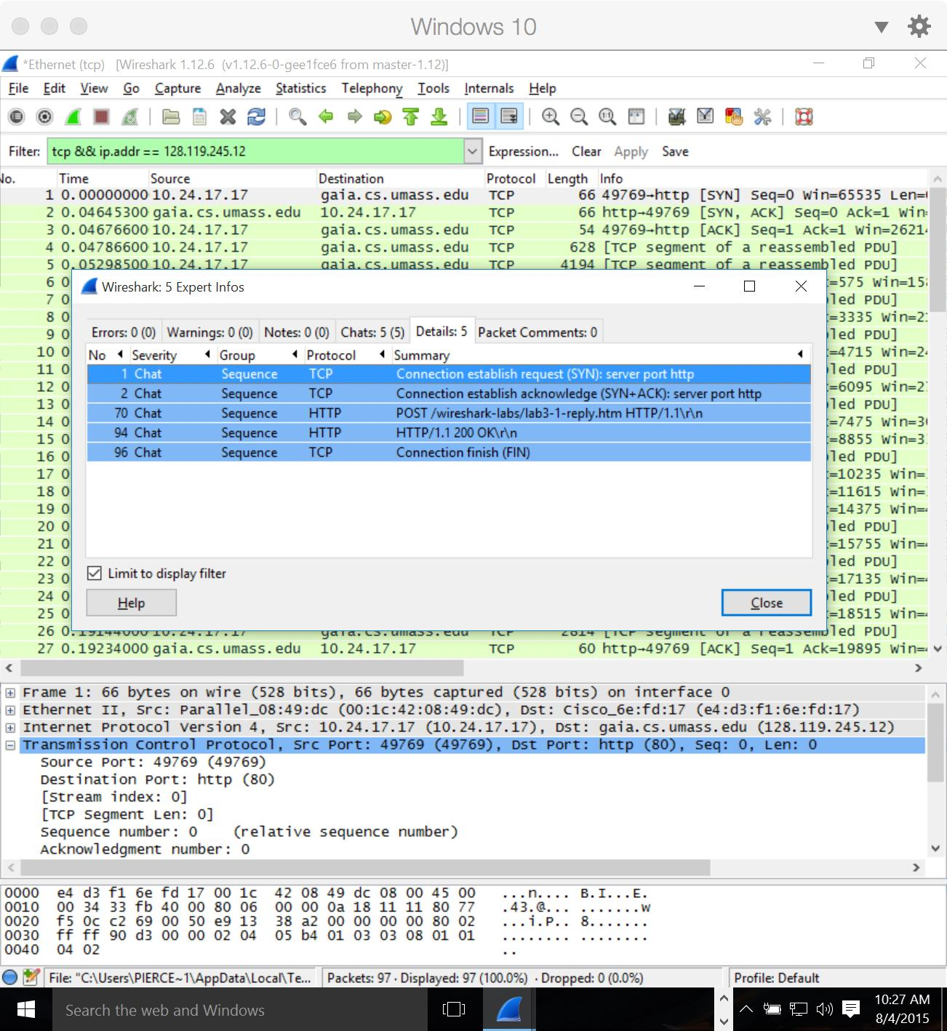
Useful stuff I found

Slide 30
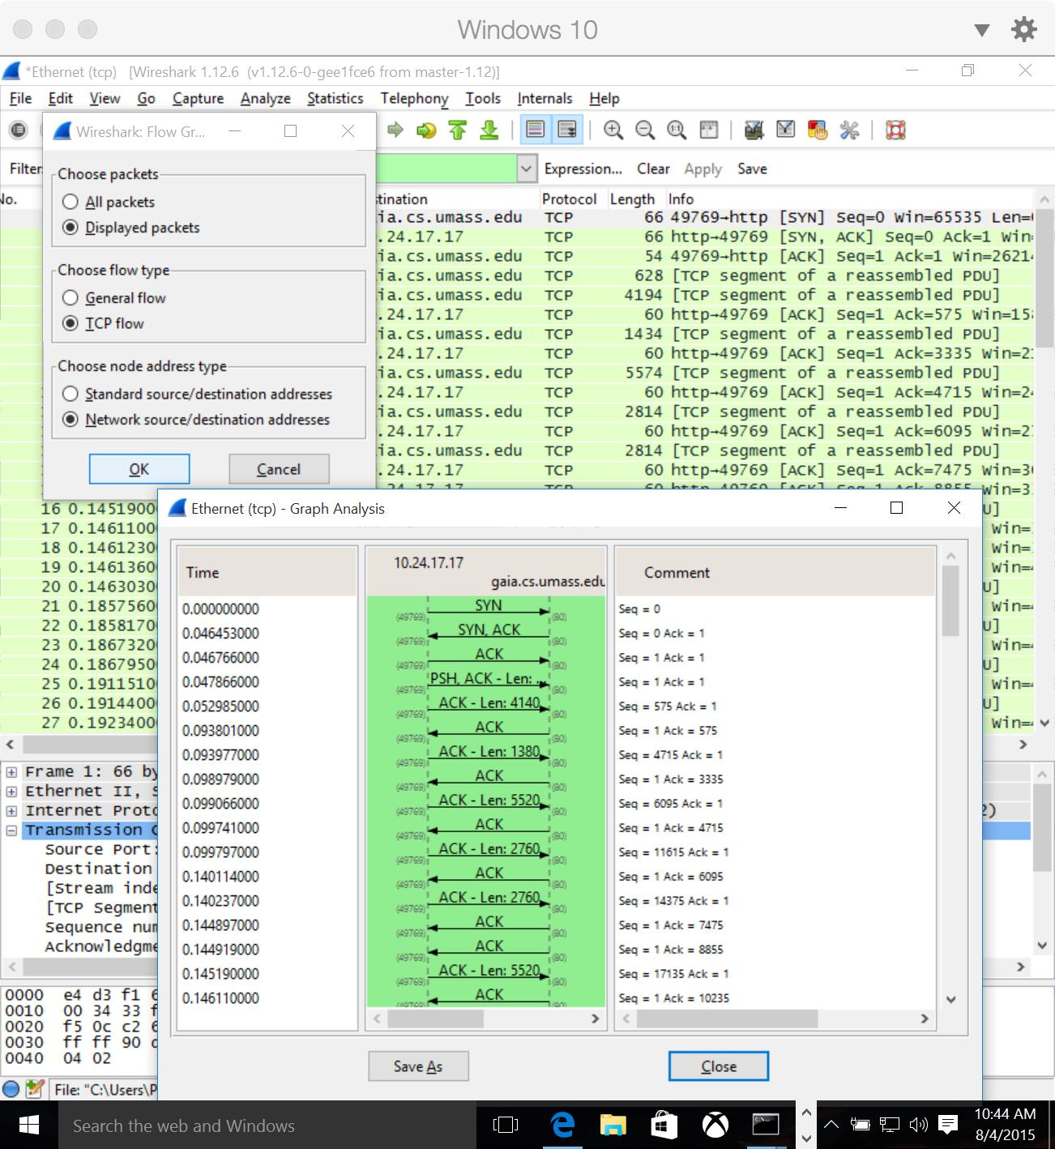
Useful stuff I found
Statistics >
Flow Graph

Slide 31
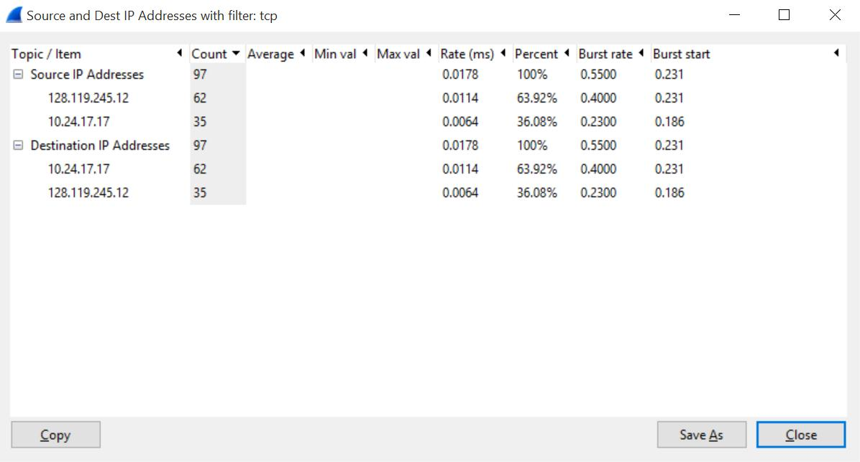
Useful stuff I found
Statistics >
IP Statistics >
Source and
Dest IP
Addresses

Slide 32
IP
The Handsome Seastars

Slide 33
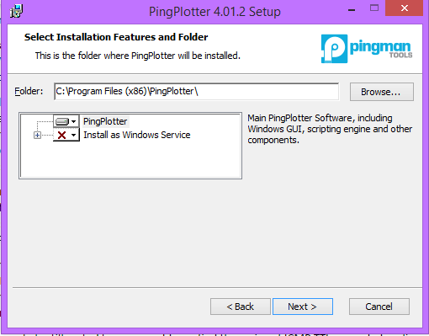

Installing Pingplotter
Pingplotter was given in the “Resources” folder, not found online for this lab
Simply “Next”-ing through the installation is fine for this program

Slide 34
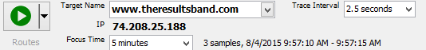
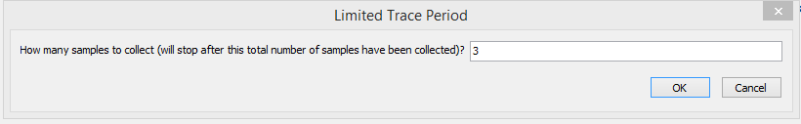
Starting Packet Capture
Start by filling out “Target Name” for the domain you want
Next click the drop down arrow next to the big green “Play” button.
Then select “Trace packets for___”
Then you can enter the ammount of samples to collect.

Slide 35
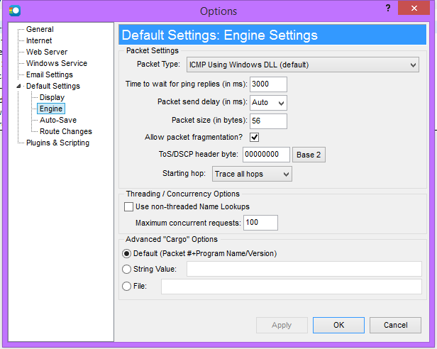
Starting Packet Capture
To change packet size, start by going to Edit -> Options
Under Default Settings -> Engine we can find the “Packet Size” field
Here we can enter the desired 56

Slide 36
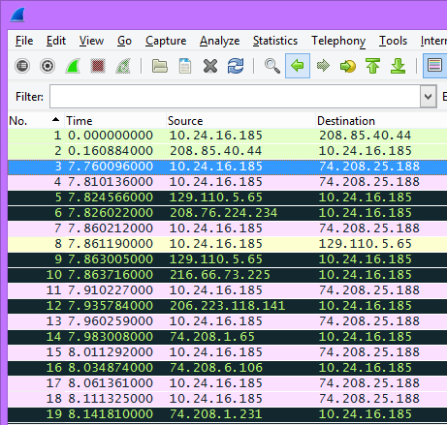
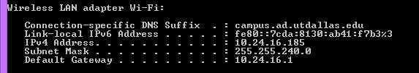
Personal IP
The IP Address of this computer is 10.24.16.185, as shown as the source for the packets
This can also be found in ‘cmd’ with the ‘ipconfig’ command
Under WLAN Adapter for Wifi -> IPv4 Address

Slide 37
Upper Layer Protocol Field Value
In the first packet from pingplotter (3) we can see under the ‘Protocol’ field that ICMP is the value for those packets

Slide 38
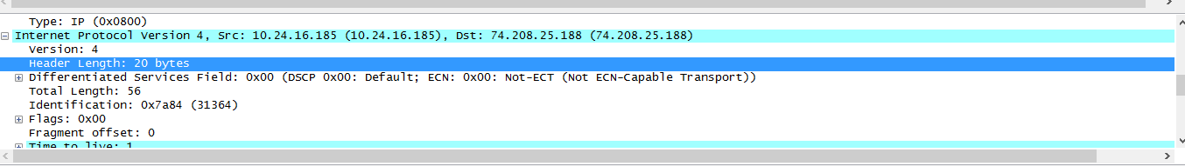
IP Header
With the packet select we can scroll down to “Internet Protocol” and click the “+”
The “Header Length” with a value of 20 byte.
The “Total Length” has a value of 56, as set in PingPlotter
Subtracting the Header Length (20) from the the Total Length (56) yields the size of the payload from the IP Datagram (56-20 = 36) which is 36.

Slide 39
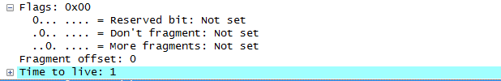
Fragmentation
Under the “Flags” drop down there is the “More fragments:” field this value is equal to 0, meaning the packet is not fragmented

Slide 40
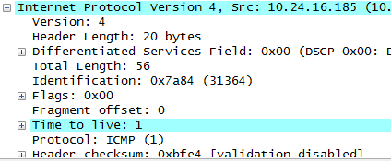
Field Changes per ICMP
Under the “Internet Protocol Field” certain fields change with every ICMP
These fields are “Identification,” “Time to live,” and “Header Checksum”

Slide 41
Field Constants
The fields that stay constant are:
Version
Because all packets are IPv4 Packets
Header Length
Because all ICMP packets have the same header length
Source IP
Because all packets are from google.com
Destination IP
Because all packets are going to the same
Differential Services
Because all ICMP use the same Type of Class
Upper Layer Protocol
Because all the packets are ICMP

Slide 42
Field Changes
The fields that change are
Identification
Because IP Packets must have different IDs
Time to live
Traceroute increments each subsequent packet
Header Checksum
Since header changes so must checksum

Slide 43

Find the Pattern
For each ICMP request packet both the Identification and Header Checksum fields increase as well

Slide 44

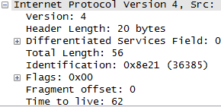
ICMP TTL-exceeded
With the “Time to live exceeded in transit” packet selected
Still under the Internet Protocl drop down
The ID is: 36385
The TTL is: 62
How morbid
Packet 36385
0-62

Slide 45
Changes in these fields
Identification
Identification must change for every packet, if they are the same then it’s the same packet or a fragment of the same packet
TTL
TTL stays the same because the travel time between the first hop is the same, so all TTLs for that hop are the same

Slide 46
DNS
The Handsome Seastars

Slide 47
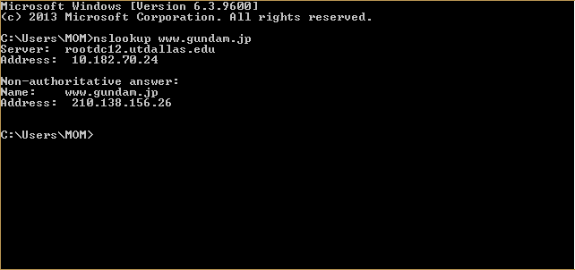
Run nslookup to obtain the IP address of a Web server in Asia.
Address: 210.138.156.26

Slide 48
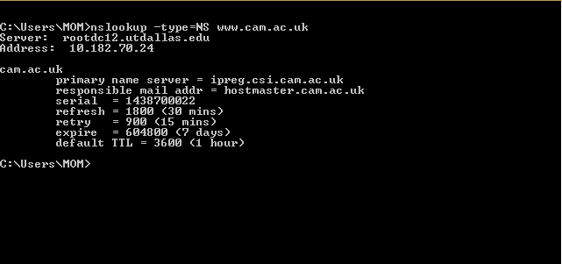
Run nslookup to determine the authoritative DNS servers for a university in Europe
Authoritative DNS server: ipreg.csi.cam.ac.uk

Slide 49
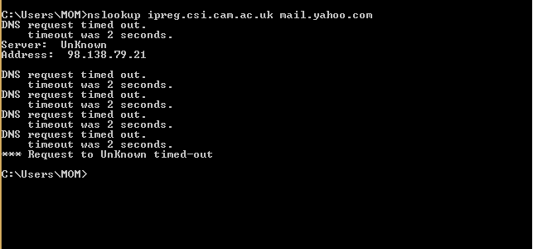
Run nslookup so that one of the DNS servers obtained in Question 2 is queried for the mail
servers for Yahoo! mail.
Address: 98.138.79.21

Slide 50
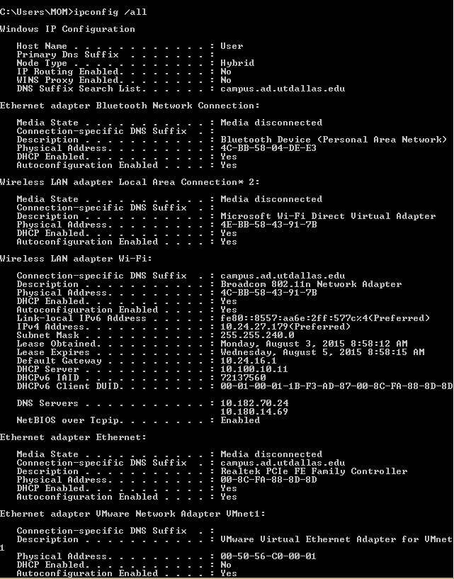
ipconfig
/all : Displays the full TCP/IP
configuration for all adapters.

Slide 51
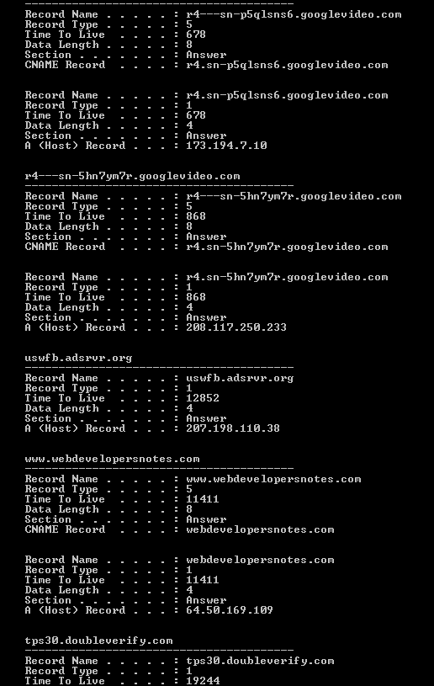
ipconfig cont.
/displaydns : Displays the contents
of the DNS client resolver cache

Slide 52
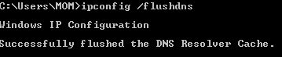
ipconfig cont.
/flushdns : Flushes and resets the
contents of the DNS client
resolver cache

Slide 53
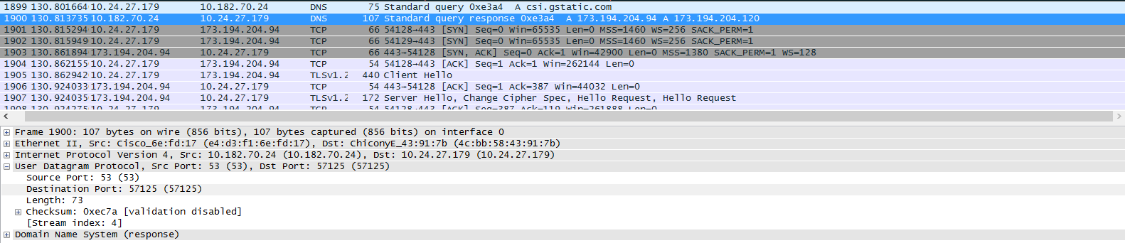
Locate the DNS query and response messages. Are they sent over UDP or TCP?

Slide 54
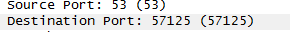
What is the destination port for the DNS query message? What is the source port of DNS response message?

Slide 55
To what IP address is the DNS query message sent? Use ipconfig to determine the IP address of your local DNS server.

Slide 56
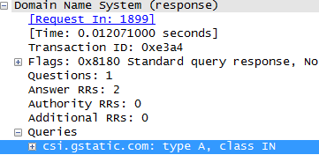
Examine the DNS query message. What “Type” of DNS query is it? Does the query message contain any “answers”?
This was a type A query and it did not contain any answers.

Slide 57
Consider the subsequent TCP SYN packet sent by your host. Does the destination IP address of the SYN packet correspond to any of the IP addresses provided in the DNS response message?

Slide 59
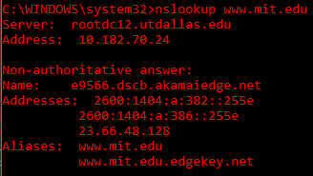
Start packet capture, then do an nslookup on www.mit.edu. You’ll find three DNS queries and responses, but for the purpose for the purpose of this lab, just focus on the last query and response message.

Slide 60
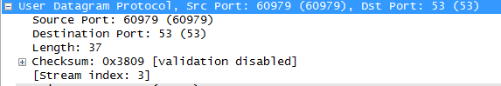
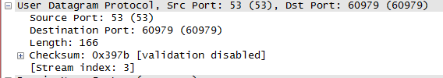
What is the destination port for the DNS query message? What is the source port of DNS response message?
As you can see they are both the same: Port 53

Slide 61


To what IP address is the DNS query message sent? Is this the IP address of your default local DNS server?
The destination of our DNS query is 10.182.70.24 which is also the IP of our server

Slide 62

Examine the DNS query message. What “Type” of DNS query is it? Does the query message contain any “answers”?
It looks to be a “standard query” and there are no answers

Slide 63

Examine the DNS response message. How many “answers” are provided? What do each of these answers contain?
There are 4 answers which contain the name, type, class, time to live, data length, and CNAME

Slide 64

Do another capture with nslookup –type=NS mit.edu

Slide 65

To what IP address is the DNS query message sent? Is this the IP address of your default local DNS server?
The destination of our DNS query is 10.182.70.24 which is also the IP of our server

Slide 66

Examine the DNS query message. What “Type” of DNS query is it? Does the query message contain any “answers”?
It looks to be another “standard query” and there are no answers again

Slide 67

Examine the DNS response message. What MIT nameservers does the response message provide? Does this response message also provide the IP addresses of the MIT namesers?
It only provides one: use2.akam.net and it does provide its IP which is 96.7.49.64

Slide 68


Do another capture with nslookup www.aiit.or.kr bitsy.mit.edu

Slide 69



To what IP address is the DNS query message sent? Is this the IP address of your default local DNS server? If not, what does the IP address correspond to?
The destination of our DNS query is 18.72.0.3 which nslookup says is “unknown”. So I looked it up and it seems to be MIT’s DNS server

Slide 70

Examine the DNS query message. What “Type” of DNS query is it? Does the query message contain any “answers”?
It looks to be another “standard query” and there are no answers again

Slide 71

Examine the DNS response message. How many “answers” are provided? What does each of these answers contain?
There is one answer which contains the name, type, class, time to live, data length, and CNAME

Slide 72
UDP
The Handsome Seastars

Slide 73


Select one UDP packet from the trace. From this packet, determine how many fields there are in the UDP header and name those fields.
Source Port
Destination Port
Length
Checksum

Slide 74

Determine the length (in bytes) of each of the UDP header fields.
Each Ascii character on the right represented by the number on the left is 1 byte

Slide 75
The value in the Length field is the length of what?
What is the maximum number of bytes that can be included in a UDP payload?
The sum of the eight bytes in the header and the remaining data
The length is 2 bytes or 16 bits, therefore the maximum bytes in the packet is 2^16(65536) minus one(65535) to include the 0th packet. Minus the 8 used in the header. 65536-1-8 = 65527

Slide 76
What is the largest possible source port number?
2 bytes, therefore the max number is 2^16(65536) minus one to account for the 0th port. = 65536 - 1 =65535

Slide 77

What is the protocol number (hexadecimal and decimal notation) for UDP?
Decimal value is 17

Slide 78

Using an Ascii chart we converted the decimal value of 17 to the hexadecimal value of 11

Slide 79

Examine a pair of UDP packets in which the host sent the first UDP packet and the second UDP packet is a reply to this first UDP packet. Know the relationship between the port numbers in the two packets.

Slide 80
Sources
http://www.cs.ucy.ac.cy/courses/EPL324/tutorials/Wireshark_IP_SOLUTION_V6.0.pdf
https://ncwebster.wordpress.com/wireshark-lab-3/

